Slide 1
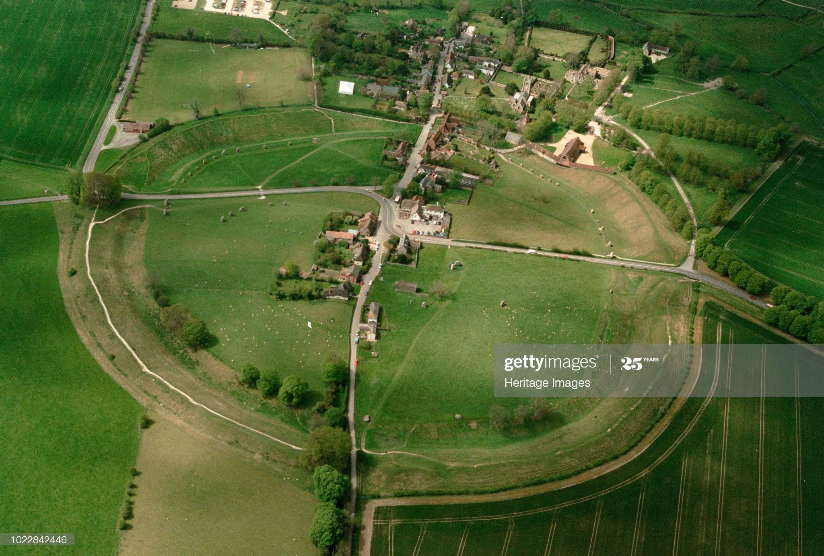
Avebury

Slide 2
This is what Avebury looks like.

Slide 3
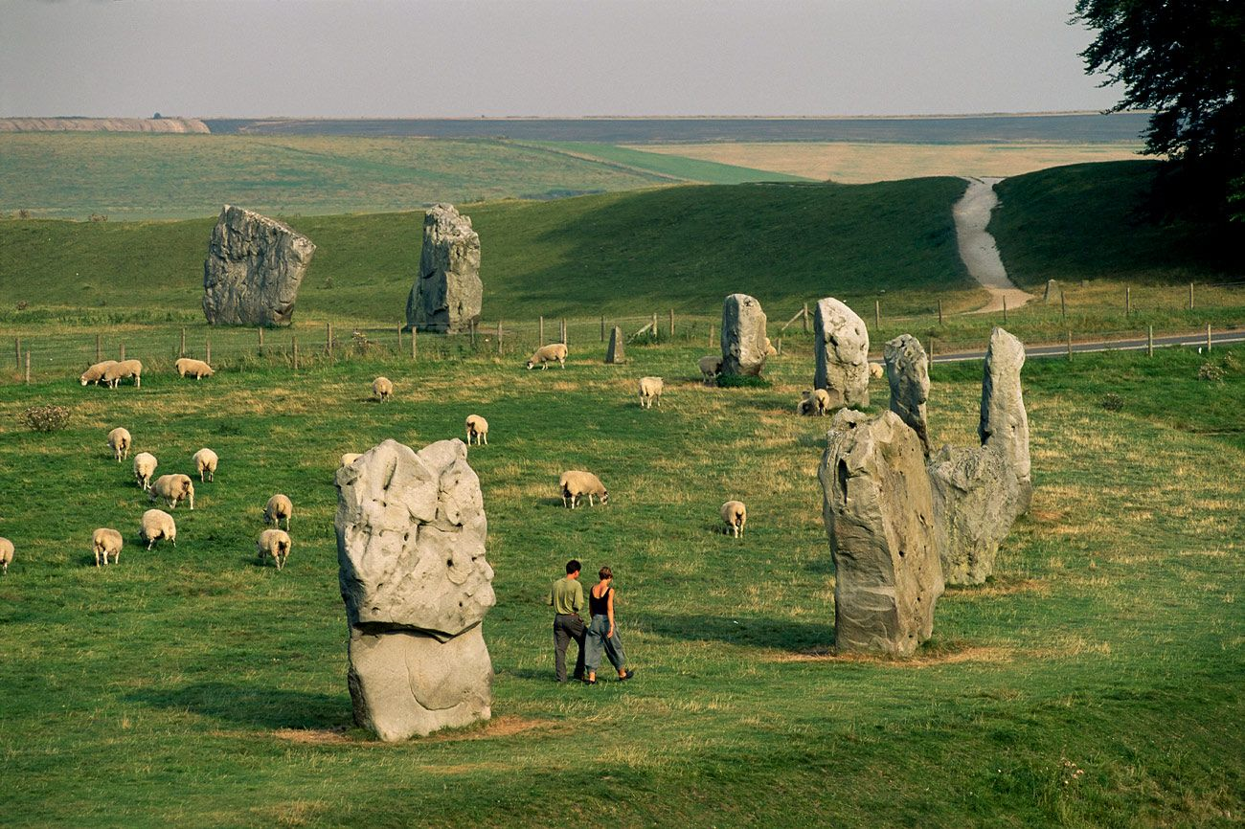
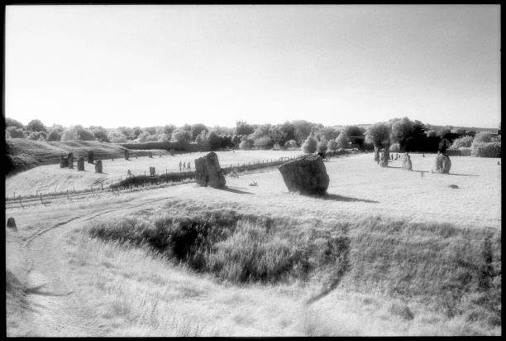
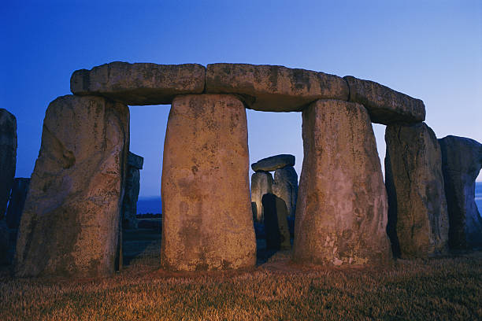
How it used to look and how it looks now.
It has changed a lot over the year’s!

Slide 4
How did the stones get there? They got some rope, logs and moved giant stones, some people got spires and puled.

Slide 5
Fact
The stones were moved by logs and they got some rope and tied it around stones.
A barber stones was named after a barber who died.
A henge is a big circle of stones .Henge stones is a around 13 feet.

Slide 6
Finally now you know about the wonderful Avebury. Phoebe and Mylo.

